Slide 1

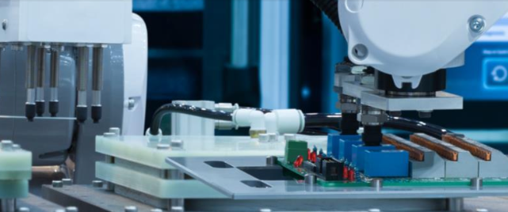
Smart. Innovative. Affordable

Slide 2
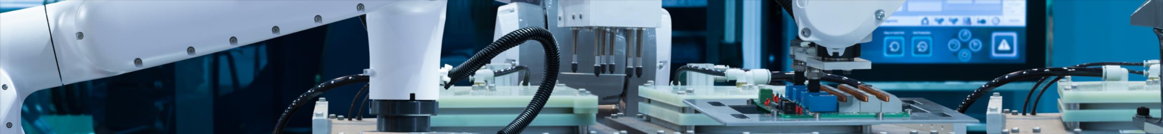

About Caerus Power Technology
Caerus is a leading provider of high-quality Power Supplies.
We offer scalable Power solutions for the Industrial, IT, Telecom, Medical, Defense and Personal Device sectors.
Founded by Tadmor Ganir and located in Las Vegas, Caerus partners with leading OEMs globally to offer our own branded products.
Designed to meet the most demanding standards, we provide advanced Power solutions with exceptional power density at competitive prices.

Slide 3
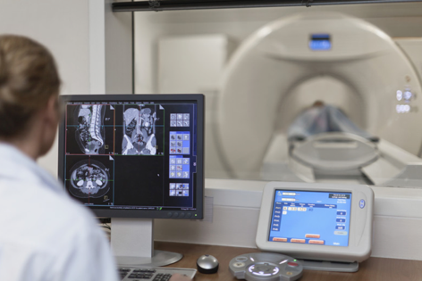
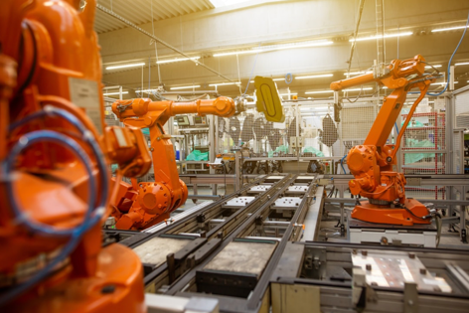


Applications
Healthcare
Industrial
ITE
Defense

Slide 4

Caerus Power Technology - Solutions
Standard Products

Slide 5
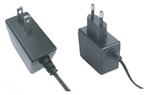

Caerus Power Standard Products
Wall Mount AC-DC Power Supply
I.T.E. - Medical - Interchangeable

Slide 6
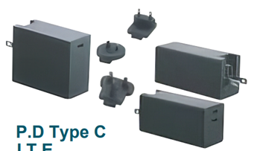

Caerus Power Standard Products
Wall Mount AC-DC Power Supply
P.D. Type-C - I.T.E. - Interchangeable

Slide 7
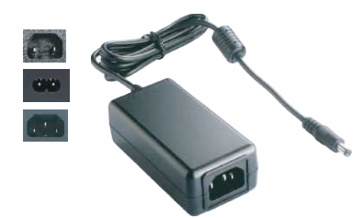
Caerus Power Standard Products
Desktop AC-DC Power Supply
I.T.E. - Medical - GaN FET

Slide 8
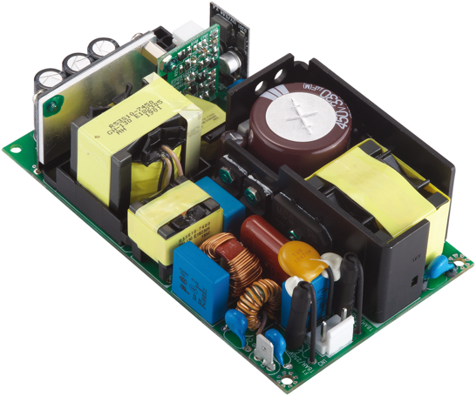
Caerus Power Standard Products
Open Frame AC-DC Power Supply
I.T.E.
Medical

Slide 9
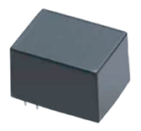

Caerus Power Standard Products
AC-DC Power Modules

Slide 10
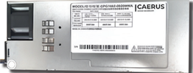
Caerus Power Standard Products
CRPS AC-DC Power Supplies
Slim - Shelf - ATX - SFX - MATX - TFX - PDB

Slide 11
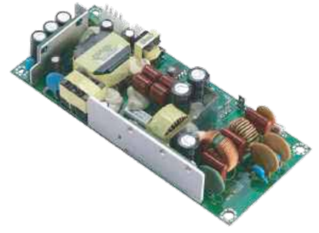
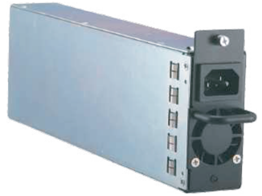
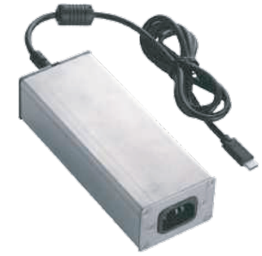
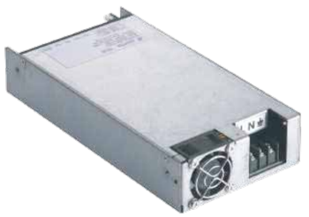
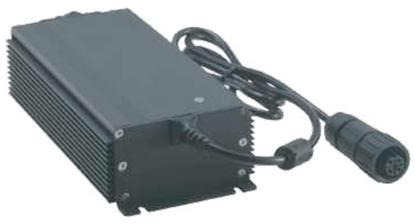
Caerus Power Standard Products
Special Applications
600W 1U Rack Mount
Marine Negative Input Voltage
Military Grade AD-DC
Adjustable 500W Power Supply
Automotive DC-DC

Slide 12

Caerus Power Technology - Solutions
Custom & Modified Products

Slide 13

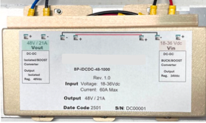
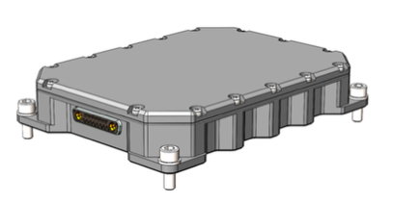
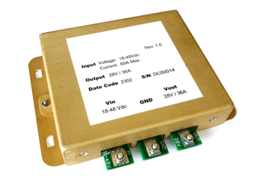
1KW 24V-48V DC-DC converter
Rugged 4 isolated Channels DC-DC converter
1KW DC-DC Converter
Wide input range 9-48Vdc, 24 or 28 Vdc output

Slide 14

Caerus Custom & Modified Solutions
Custom
From Low Power to Kilowatts, we Custom Design and Produce the Exact Power Solution for Your Needs
Modifications
Our unique capabilities allow us to easily modify standard product:
DC Cable Length Adjustment
Connector Type Change
Output Voltage Adjustment
Adding Ferrite Beads / Chokes
Conformal Coating
Custom Labeling and Branding
Cheaper and quicker than designing a custom supply
MOQ’s as low as 100 pcs.

Slide 15
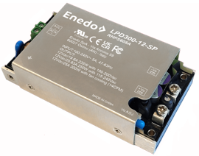
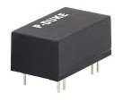
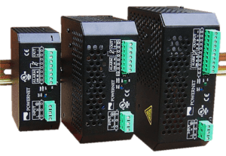
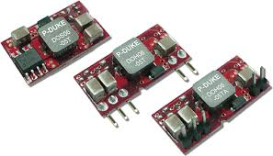
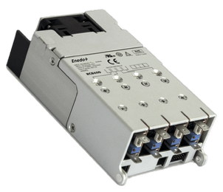
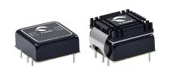
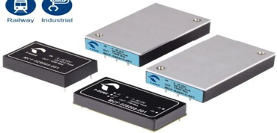

Can’t find the Power Supply you need from Caerus No Problem!
AC-DC Power
Open Frame 15-500W
Enclosed 40-500W
Encapsulated 6-500W
Thru Hole 6-500W
Configurable Multi-Output
DC-DC Power
SMD 1-15W
SIP 1-12W
DIP 10100W
Brick 40-300W
Chassis Mount
DIN-Rail 15-300W
Accessories
Surge Protectors
Surge / EMC Filters

Slide 16


Smart. Innovative. Affordable

